Slide 1

SLWC Fundraiser
Presented By
Daniel Tilley
Conor Murphy
Tariq Saleh Al-mulhim
Fahad Alothman
Liam Lalor

Slide 2
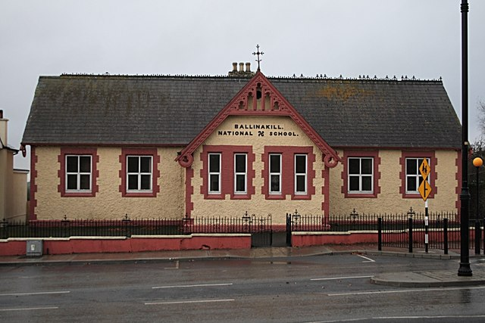
Our Idea
Non uniform day
Halloween Fancy Dress
Primary school
Ballinakill, Co Laois

Slide 3
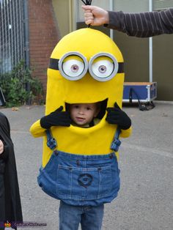
Why we chose this
Simplicity
Person on the inside!
Halloween around the corner
School wanted a new charity

Slide 4
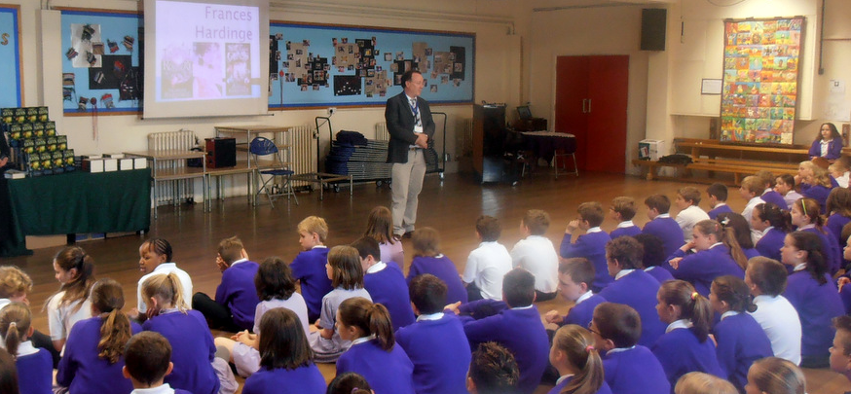
Was it successful?
Money raised for a great cause
Awareness raised for Wells for Zoë
Children loved the event
Talk given to children and parents

Slide 5
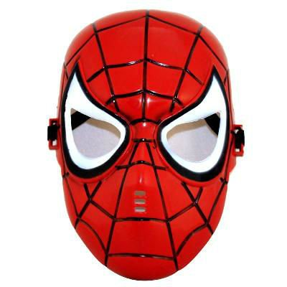

Changes we would make
Get more people involved
Advertise the event more
Prizes for the best dressed children

Slide 6

What we learned
Importance of teamwork
How to organise an event
How to build new relationships

Slide 7

Questions?

